Slide 1

UNIT
DAY 23
02
AND, OR, NOT
BUILT TO ORDER
AGENDA
REMINDERS
Phones into The Holding Cell
Open/Closed Laptop
Lab open/accessible
Warm Up
Step by Step
and / or / not
Evaluation Traps
The Ride Checker
Close
Vocabulary
RECOMMENDED LISTENING:
WORLD BOWSER – SUPER MARIO 3D WORLD
Notes:
Day 23, Unit 2-6. Phones away, laptops open, Lab 2-6 open before the warm up. Yesterday conditions were single comparisons. Today we combine them and look closely at how Python works out the answer.

Slide 2

THE WARM UP QUESTION
Recall from last lesson. Answer from memory, no running it yet.
a) What does it print? b) What do the two conditions evaluate to?
score = 85
if score >= 90:
print("A")
elif score >= 80:
print("B")
else:
print("Keep practising")
→ Lab Warm Up: answer a) and b) from memory, then run it to check.
Notes:
This is a recall question on Day 22. Students answer from memory first, then run it to check. Part b) sets up today: each if and elif line is really a question with a True or False answer.

Slide 3
THE WARM UP ANSWER
It prints B.
Each if and elif line asks a question that is either True or False.
→ Lab Warm Up: correct anything you got wrong.
score = 85
if score >= 90: # False, so skip this branch
print("A")
elif score >= 80: # True, so print B and stop
print("B")
else: # never checked
print("Keep practising")
Notes:
Cold-call for each condition’s value. Then make the link to today: every if and elif line is a question that Python boils down to True or False. Today is about how it works out that answer when conditions are combined.

Slide 4
STEP BY STEP
Python checks each comparison first: age >= 12 is True, height >= 140 is False.
Then it combines them: True and False evaluates to False.
The whole condition is False, so the else branch runs.
age = 15
height = 130
if age >= 12 and height >= 140:
print("You can ride!")
else:
print("Sorry, not this ride.")
Notes:
Ask the class for the value of each comparison before revealing the bullets. Then change height to 150 and ask what changes. Students do this same kind of working out in Lab question 2.

Slide 5
AND, OR, NOT
and: True only if both sides are True.
or: True if at least one side is True.
not: flips the value.
A truth table lists every combination.
→ Now: Lab questions 1–2
A | B | A and B | A or B | not A
True | True | True | True | False
True | False | False | True | False
False | True | False | True | True
False | False | False | False | True
Notes:
Fill in the table live with the class before revealing it: cover the last three columns and ask for each row. A quick memory hook: and is strict, or is generous.

Slide 6
AND & OR IN CODE
Each side of and / or must be a complete condition.
Use and when every rule be true, and use or when only one is enough
age = int(input("Age? "))
height = int(input("Height in cm? "))
if age >= 12 and height >= 140:
print("Welcome aboard!")
elif age < 6 or height < 100:
print("Try the carousel instead.")
else:
print("Sorry, not this ride.")
Notes:
Run it three times to reach all three branches, for example 15/150, 4/95 and 10/130. For each run, have students say the step-by-step evaluation aloud.

Slide 7
NOT & BOOLEAN VARIABLES
A condition’s result can be stored in a variable, like any other value.
  Yes, this code looks very confusing to read lol
not reads naturally with a Boolean variable: if not with_adult:
→ Now: Lab questions 3–4
answer = input("Is an adult with you (yes/no)? ")
with_adult = answer == "yes"
if not with_adult:
print("You need an adult for this ride.")
else:
print("Enjoy the ride!")
Notes:
The line with_adult = answer == "yes" is worth slowing down on. Read it right to left: the comparison is evaluated first, and the True or False it produces is stored in with_adult.

Slide 8
THE OR TRAP
The first version says "You picked a fruit!" for anything, even carrot.
Each side of or is checked on its own, and "banana" on its own counts as True, as most things do in Python
food = input("Pick a food: ")
# Broken: always True
if food == "apple" or "banana":
print("You picked a fruit!")
# Fixed: compare food on both sides
if food == "apple" or food == "banana":
print("You picked a fruit!")
Notes:
Demo the broken version live and type carrot. The fix is to write the full comparison on both sides of or. This is Lab question 5, so show the cause but leave the fixing to them.

Slide 9
PREDICT THE OUTPUT
What prints for each input?
25, no
25, yes
15, no
15, yes
→ Now: Lab questions 5–6
temp = int(input("Temperature? "))
answer = input("Raining (yes/no)? ")
raining = answer == "yes"
if temp > 20 and not raining:
print("Picnic time!")
elif temp > 20 or not raining:
print("Go for a walk.")
else:
print("Stay inside.")
Notes:
Answers: 25/no prints Picnic time! 25/yes prints Go for a walk (the first condition is True and False, so it fails, but the or condition passes). 15/no also prints Go for a walk. 15/yes prints Stay inside, because both sides of the or are False. Ask students to justify each answer with the value of each part.

Slide 10
THE RIDE CHECKER
Write the entry checker for a theme park ride of your own design.
Ask at least three questions, and cast at least two answers
Use and, or and not at least once each
Store a yes / no answer as a Boolean variable
Reach at least three outcomes with if / elif / else
Print a clear message for every outcome
→ Lab questions 7–8 (the checklist is in Section 4)
Notes:
This is Lab Section 4 and the main task. Encourage students to write their rules in plain English first, like a sign at a ride entrance, and then translate each rule into a condition.

Slide 11
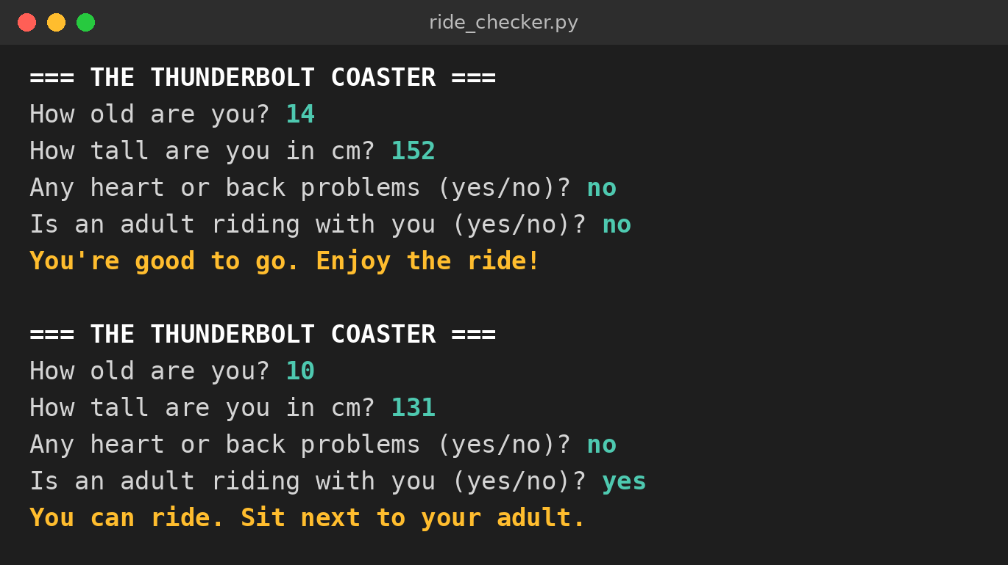
WHAT IT LOOKS LIKE
Two runs of the same program, two different outcomes.
The second rider is too young to ride alone, but with_adult is True.
→ What would a 10-year-old with no adult see?
→ Now: Lab question 7
Notes:
Callout answer: "You need an adult with you for this ride." In the sample solution, the order is: unsafe (health problem or under 120 cm), then old and tall enough to ride alone, then not with_adult, then else rides with an adult.

Slide 12
CLOSE
→ Exit question: the user types Yes with a capital Y. What is stored in with_adult, and why?
answer = input("Is an adult with you (yes/no)? ")
with_adult = answer == "yes"
Save your lab as Surname_Lab2-6 and upload it to ManageBac.
→ Lab question 8: trace one of your own conditions before you upload.
Notes:
Exit answer: False. "Yes" == "yes" is False because comparisons between strings are case-sensitive, so a rider with an adult would be turned away. Point students to the lab extension, which uses .lower() to fix it.

Slide 13
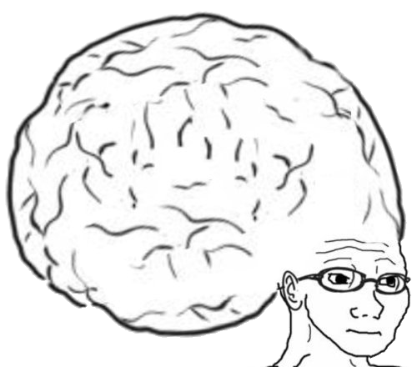
VOCAB TO REMEMBER
Evaluate - work out the single value an expression produces
Boolean - a True or False value
and - True only when both sides are True
or - True when at least one side is True
not - flips True to False and False to True
Truth table - every combination of inputs and the result
Compound condition - two or more conditions joined with and / or
Boolean variable - a variable that stores True or False
Notes:
Quick-fire: read a definition, students call out the term.

Slide 14
FURTHER READING
Python docs: Boolean operations
Python docs: Truth value testing
W3Schools: Python Logical Operators
W3Schools: Python Booleans
Real Python: The "and" Operator
Notes:
Share the links on ManageBac for anyone who wants more practice.

